Slide 1
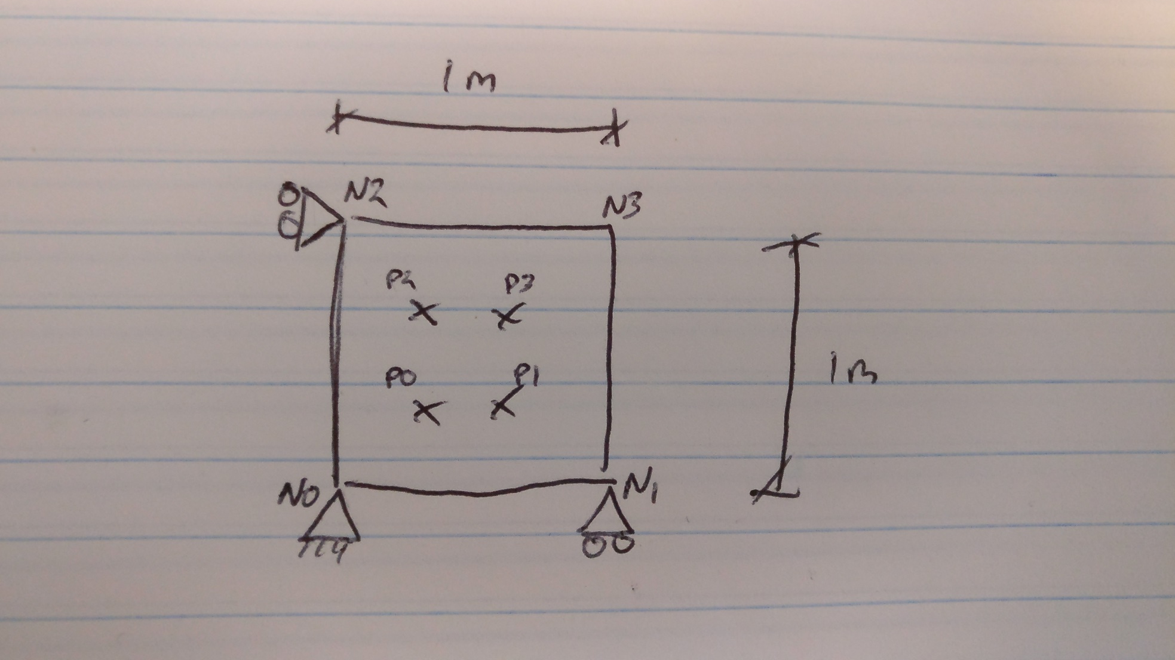
Problem

Slide 2
3 Cases of Initial Conditions
Case 1: with both vertical and horizontal initial stress (50 kPa)
Case 2: with just vertical initial stress
Case 3: without any initial stress
Point | Initial |  | 1 |  | 2 |  | 3
 | x | y | x | y | x | y | x | y
0 | 0.211325 | 0.211325 | 0.211325 | 0.223107 | 0.211325 | 0.223628 | 0.211325 | 0.209838
1 | 0.7886275 | 0.211325 | 0.7886275 | 0.223107 | 0.7886275 | 0.223628 | 0.7886275 | 0.209838
2 | 0.211325 | 0.7886275 | 0.211325 | 0.832648 | 0.211325 | 0.834515 | 0.211325 | 0.783215
3 | 0.7886275 | 0.7886275 | 0.7886275 | 0.832648 | 0.7886275 | 0.834515 | 0.7886275 | 0.783215

Slide 5
Reaction Nodal Forces
Node | 1 |  | 2 |  | 3
 | x | y | x | y | x | y
0 | 70320.4 | -26352.8 | 0 | -31770.7 | 0 | -28518.4
1 | -70320.4 | -17895.9 | 0 | -10590.2 | 0 | -9506.13
2 | 25215.7 | 26352.8 | 0 | 31770.7 | 0 | 28518.4
3 | -25215.7 | 17895.9 | 0 | 10590.2 | 0 | 9506.13

Slide 6
Reaction Nodal Forces -
Internal + External
Node | 1 |  | 2 |  | 3
 | x | y | x | y | x | y
0 | -58930.8 | -107559 | -58930.8 | -107559 | -58930.8 | -107559
1 | 58930.8 | -36463 | 58930.8 | -36463 | 58930.8 | -36463
2 | -19913.4 | 31375.7 | -19913.4 | 31375.7 | -19913.4 | 31375.7
3 | 19913.4 | 10636.5 | 19913.4 | 10636.5 | 19913.4 | 10636.5

Slide 7
Next Work
To do displacement boundary to better check reaction nodes
Do more than 1 element

